Slide 1
Software Development Tools & Practices PUSL2020 Level 2
“Database Connectivity”
Dr. Rasika Ranaweera (ranaweera.r@nsbm.ac.lk | +94 11 544 6126)
Faculty of Faculty of Postgraduate Studies & Professional Advancement | NSBM Green University

Slide 2
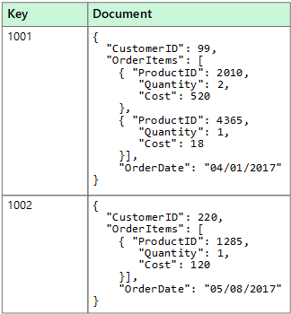



Data Sources
Flat file
txt, XML
RDBMS
Non-relational/cloud/NoSQL
Expand as data space required
Data stored in Key-Value stores
Not built on tables etc
Does not use SQL
Fine if relational model not required and immediate priority is to get large quantities of data back
Not in scope of this module.

Slide 3
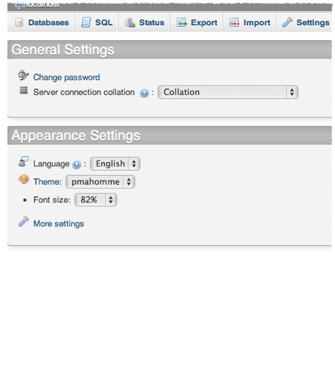
PHP & MySQL
Need to know how to create tables, columns etc.
Learn how to export data - sql dump.
Use PHP MyAdmin to control MySQL

Slide 4
Connections
Connection to data source is required whatever language
PHP = number phases
1. Set connection:
$connection = mysql_connect(“localhost”,”root”,”password”);
change localhost to servername when needed.
2. Select the database to be used
$db = mysql_select_db(“databasename”, $connection);
function returns a true value if it worked!
3. If true, retrieve rows etc. More code samples given in practical next week

Slide 5
ASP.NET
In OO world!
Number of data objects in toolbox
Designed to link into Microsoft Sql Server
Drop SqlDataSource web controls and configure
Useful for straightforward queries
Data aware components link to the data source
So.. change data type - just change data source.
Hides implementation of connection string

Slide 6
ASP.Net Connection Strings
Connection strings are just ordinary strings that contain all the information ASP.Net needs to create the database connection and then configure it for use.
This information includes the address of the database server, your username and password, and any default settings your database needs to run correctly.
With ASP.Net, you want to put your connections string in your web site’s web.config file. This way you can change databases without having to edit your code at all.

Slide 7
ASP.Net Connection Strings (Cont.)
<configuration>
.
.
.
<connectionStrings>
<add name=”MyDatabaseConnectionString” connectionString=”Server=MyDataServer;Integrated Security=SSPI;Database=MyDatabase;" providerName=”System.Data.SqlClient” />
</connectionStrings>
.
.
.
</configuration>

Slide 8
Connecting to the Database in Code
The entire ADO.net framework exists under the System.Data namespace, so you will need to include it everywhere you need to use this “in code” method.
You do this with either the using C# statement in your code file or the Import ASP.Net directive in your web form file.
using System.Data.SqlClient;
//or
<%@ Import Namespace=”System.Data.SqlClient” %>

Slide 9
Connecting to the Database in Code (Cont.)
Once you have the right namespace set, you can start connecting to your database through a connection object.
Each database namespace has its own connection object. It usually has the name of the database type followed by the word Connection.
You set the connection string through the connection objects ConnectionString property or as an argument of its constructor.
You can use the ConnectionStrings collection of the built in ConfigurationManager to get your connection string from web.config.
string connStr = ConfigurationManager.ConnectionStrings["MyConnectionString"].ToString();
SqlConnection mySQLconnection = new SqlConnection(connStr);

Slide 10
What is Data Binding?
We evaluate, at run time, expressions to get data from
In-memory tables
Server-side variables
And other things

Slide 11

Creating a Binding
In the ASPX page (not the C# file), we embed expressions in some “special” character strings
Data binding expressions are contained between <%# %>

Slide 12
Executing a Binding
Data binding has a place in the page lifecycle
It occurs automatically in some cases depending on the setting of control properties
In some cases, you must force the binding to execute
Call DataBind() on the page or control
this.DataBind()

Slide 13
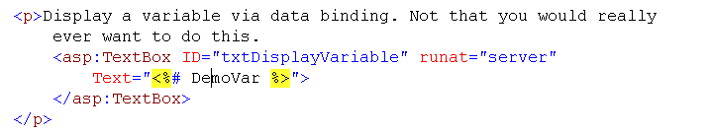
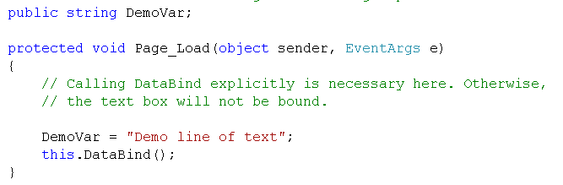
Binding Example 2
Bind to a form variable

Slide 14
Binding Example 3
Use data binding to call a function on the current page (The function is named SampleFunction)
<asp:Label ID="Label2" runat="server"
Text="<%# SampleFunction()%>"> </asp:Label>
Notes:
IS EDITABLE usvalidation line 651.
&nbsp;<asp:LinkButton ID="lbNew" Visible="<%# IsEditable %>"
runat="server" CausesValidation="False" CommandName="New"
Text="New"></asp:LinkButton>
Code behind line 67.
public bool IsEditable
{
get
{
// sb _iseditable
return true;
}
set
{
_isEditable = value;
}
}

Slide 15
Possible Data Sources
Anything that can be enumerated (foreach loop) can serve as a data source
Collections for example
Dictionary and so on
ADO.NET DataSet and DataTable
We bind controls to data sources

Slide 16
ASP.NET Data Source Controls
They add a layer of abstraction to simplify your life
They create the SqlDataAdapter, DataSet and DataTable for you
They take care of the binding details too
SqlDataSource, ObjectDataSource, XmlDataSource

Slide 17
ASP.NET SqlDataSource
It gets declared in the .ASPX file.
It can be created programmatically or via a UI tool
Define a connection string to a db
Build the statements
Enabled updates deletes (optional)
Test the query

Slide 18
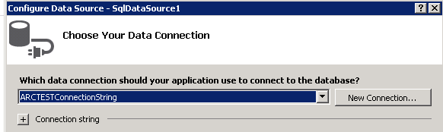
ASP.NET SqlDataSource
Select an existing connection or create a new one
Same connection that you have been working with

Slide 19
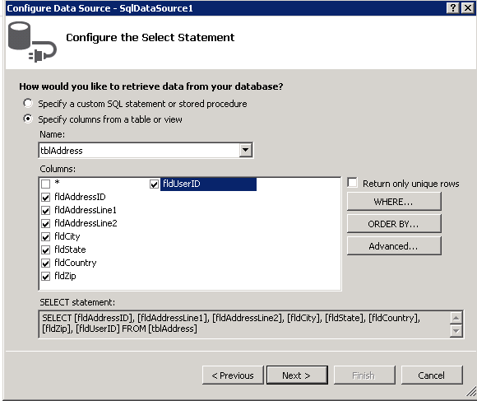
ASP.NET SqlDataSource
Select the tables and fields

Slide 20
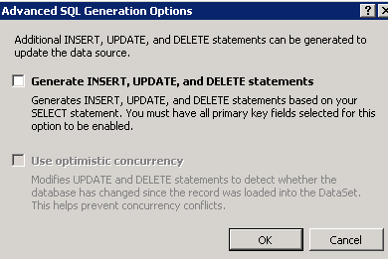
ASP.NET SqlDataSource
Optionally generate INSERT, UPDATE, and DELETE statements

Slide 21
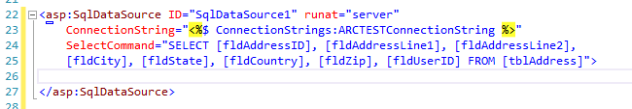
ASP.NET SqlDataSource
The results
Notes:
Go back and generate the udpates
Explain the updates.
Show how to reference parameters at run time.
ucValidationfv at line 456
DropDownList dd;
dd = (DropDownList)fvValidationSiteDetail.FindControl("ddPavementSiteType");
sdsValidationSiteDetail.InsertParameters["fldPavementSiteTypeID"].DefaultValue =
dd.SelectedValue;
Shows pointing to stored procedures. At line 62

Slide 22
Using the SqlDataSource
Once a data source has been created, we bind controls (and other things) to it

Slide 23
Binding (Simple)
We associate an ASP control to a single value
It can be just about anything
An executable expression
A variable
A data binding expression
This is what we did in the preceding example

Slide 24
Binding (Repeated)
Repeated (list)
We bind to a list (hence repeating data)
Repeated data binding is used with “list” controls such as list boxes and combo boxes

Slide 25
Types of Complex Bound Controls
Controls can be bound to a data source
Basically, repeating controls are of three types
List controls use a template for each item found in the data source
Iterative controls allow you to create a custom template for each row that is bound
View controls are the richest (DetailsView, FormView, GridView)

Slide 26
List Controls
These are our ListBox, DropDownList, CheckBoxList and RadioButtonList
They display a single field of information having multiple rows
The can be associated with a single-field hidden “key”

Slide 27
List Control Binding Properties
The DataSource and DataMember properties together bind a control instance to a data source (or DataSourceID)
DataValueField: Set to the data source field that you want the to behave as a key
DataTextField : Set to the data source field that you want the user to see
The DataKeyField contains the primary key

Slide 28
Data Binding (Using a Data Source - 1 )
These properties can be set
Using the Properties window
Declaratively in .aspx files
Programmatically
Call DataBind to perform the binding

Slide 29
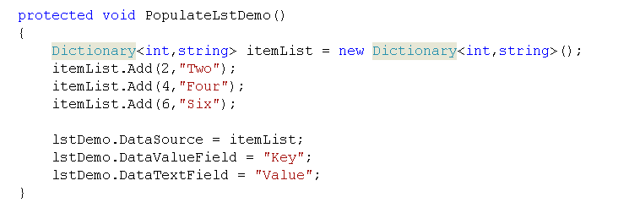
Important Binding List Controls (Example)

Slide 30
Binding List Controls (Example)
Programmatically bind a ListBox
lstDemo.DataSourceID = SqlDataSource1";
lstDemo.DataTextField = "fldInvoiceNumber";
lstDemo.DataBind();

Slide 31
List Controls (Members)
SelectedIndex contains the 0-based index of the selected list item
-1 if no item is selected
SelectedItem gets the selected item from the list
SelectedValue gets the value of the selected item
Set AutoPostBack to true to fire a postback when the user selects an item
Notes:
Show bound list boxes

Slide 32
Q & A

